Slide 1
Performance modelling of skewed demand in complex systems
Stephen Shephard
School of Computing Science, Newcastle University, Newcastle upon Tyne, NE1 7RU
s.shephard2@newcastle.ac.uk

Slide 2
Introduction
On-line Transaction Processing applications often have skewed demand for some resources
Overloading the whole system affects:
- reputation
- revenue
Cloud technologies may maintain throughput to low demand resources

Slide 3
Motivation
High profile total outages with skewed demand
- London 2012 Olympic tickets website
- HBO Go “True Detective” finale
- Apple iTunes iPhone 7 launch
Notes:
Real world examples of skewed demand

Slide 4
Outline
Use Case
Technologies
PEPA Modelling
Methods
Testing
Results
Conclusions & Future Work

Slide 5
Use Case – Olympic Ticketing
Search, book, return tickets for multiple sports: Athletics, Cycling, Diving etc.
Distributed architecture
Web-based front end
Worker applications
Middleware
Database
Athletics has known skewed demand
Notes:
Multi-sport event ticketing application using a distributed architecture. Users access the application with a web-based front end. Tickets are stored in one or more databases. In between the web servers and database are worker applications that service user requests, connected to the web servers by some middleware. This is a very general architecture, but a concrete example makes it easier to discuss.
It is assumed that there will be predictable skewed demand for athletics tickets, and a constant ‘normal’ demand for cycling etc.

Slide 6
Queue vs Microservices
Connecting components of distributed systems
Shared queue middleware
Asynchronous – good for “return tickets”
Competing consumer pattern shares demand
Microservices architecture
Smaller, dedicated components for end to end services e.g. search, book, return
Isolates the demand

Slide 7
Distributed Databases
Athletics
Athletics
Archery
Archery
Cycling
Archery
Cycling
Judo
Athletics
Judo
Diving
Judo
Diving
Fencing
Cycling
Fencing
Fencing
Diving
Notes:
Horizontal partitioning using consistent hashing by sport, tickets for each type of sport on a different data node in a “ring”.
Throughput expected to follow sport demand to the relevant data node partitition, but when using replication, each sport appears on more than one data node. Its expected that there will be throughput on each node.

Slide 8
PEPA
Performance Evaluation Process Algebra
Notes:
A PEPA model describes a system of interacting components which carry out activities at specified rates (or passive rates, T).
Mathematical language so its possible to compose complex models from simpler components.

Slide 9
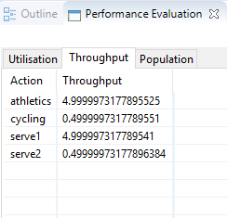
PEPA Eclipse plugin
a = 10.0; /* Athletics arrival rate */
c = 1.0; /* Cycling arrival rate */
s1 = 5.0; /* Service rate 1 */
s2 = 5.0; /* Service rate 2 */
Arrival_A = (athletics, a).Arrival_A;
Arrival_C = (cycling, c).Arrival_C;
Service_1 = (serve1, s1).Service_1;
Service_2 = (serve2, s2).Service_2;
Q_0 = (athletics, T).Q_1 + (cycling, T).Q_2;
Q_1 = (serve1, T).Q_0;
Q_2 = (serve2, T).Q_0;
Arrival_A <athletics> Q_0[20] <serve1> Service_1 <cycling> Arrival_C <serve2> Service_2
Notes:
There is a PEPA Eclipse plugin that allows PEPA models to be parsed and run like programs.
Random arrival times, negative exponentially distributed. Eclipse calculates the mean throughputs in steady state.

Slide 10
Methods
Produce simple technology component models in PEPA
Compose into system models
Simple Microservices
Shared Queue and Distributed Database
Shared Queue and Distributed Database with Replication
Experiment with models using PEPA Eclipse plugin
Test model results against actual built systems

Slide 11
System Model
a = 1.0; /* Rate of booking Athletics tickets */
c = 1.0; /* Rate of booking Cycling tickets */
d = 1.0; /* Rate of booking Diving tickets */
q = 100.0; /* Rate of consuming from queue */
db = 5.0; /* Rate of servicing DB requests */
/* Web front-end process */
Website = (athletics, a).Website + (cycling, c).Website + (diving, d).Website;
/* Shared queue process */
Q_0 = (athletics, T).Q_A + (cycling, T).Q_C +
(diving, T).Q_D;
Q_A = (queueA, T).Q_0;
Q_C = (queueC, T).Q_0;
Q_D = (queueD, T).Q_0;
/* DB node processes */
DB_1 = (queueA, q).DBsrv_1 + (queueC, q).DBsrv_1;
DBsrv_1 = (dbsrv1, T).DB_1;
DB_2 = (queueC, q).DBsrv_2 + (queueD, q).DBsrv_2;
DBsrv_2 = (dbsrv2, T).DB_2;
DB_3 = (queueD, q).DBsrv_3 + (queueA, q).DBsrv_3;
DBsrv_3 = (dbsrv3, T).DB_3;
/* Service processes for DB nodes */
Service_1 = (dbsrv1, db).Service_1;
Service_2 = (dbsrv2, db).Service_2;
Service_3 = (dbsrv3, db).Service_3;
Website <athletics, cycling, diving>
Q_0[10] <queueA, queueC, queueD>
(DB_1 || DB_2 || DB_3) <dbsrv1, dbsrv2, dbsrv3> (Service_1 || Service_2 || Service_3)
Notes:
Combining component models – queue model in red, distributed DB with replication in blue.
Shared activities in purple.

Slide 12
Testing
Build systems in Microsoft Azure cloud
Java and Java Spring
Cassandra Database
Microsoft Azure Storage Queues
Instrument the systems using CodaHale Metrics
Counts every request, takes a 1-minute rolling average every 10s
Test and measure each system 5 times and average the results
Simulate skewed demand with Apache JMeter test plans

Slide 13
Testing
Calibrate throughput measurements with Controls
Control RESTful API or Control ticket type
No database access
Record metrics, work out throughput without a database
Must deliberately slow down databases
Smallest virtual machines
Turn off all caching
Turn on 100% query tracing

Slide 14
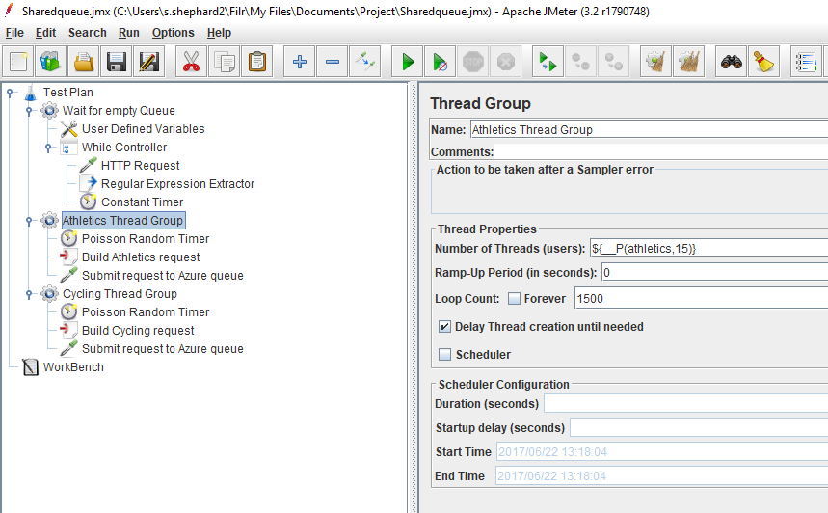
Testing - JMeter

Slide 15
System 1
Simple microservices
Notes:
Separate end-to-end services for handling athletics and cycling ticket requests. This is not a `natural' microservices implementation, which would be more likely to separate on operations e.g. searching, booking and returning tickets, but it is comparable to the distributed database models.
The system has two separate databases, one for athletics tickets, one for cycling, and each has its own dedicated worker application.

Slide 16
Results (model vs built)
Athletics demand | Athletics | Cycling
1 | 0.97 | 0.97
2 | 1.83 | 0.97
3 | 2.55 | 0.97
4 | 3.14 | 0.97
5 | 3.61 | 0.97
6 | 3.99 | 0.97
7 | 4.3 | 0.97
8 | 4.55 | 0.97
9 | 4.75 | 0.97
10 | 4.92 | 0.97
Athletics demand | Athletics | Cycling | Cycling control
1 | 0.9 | 0.9 | 0.96
2 | 1.72 | 0.88 | 0.95
3 | 2.56 | 0.88 | 0.95
4 | 3.36 | 0.87 | 0.94
5 | 4.08 | 0.86 | 0.94
6 | 4.78 | 0.84 | 0.94
7 | 5.57 | 0.85 | 0.94
8 | 6.04 | 0.82 | 0.94
9 | 6.5 | 0.8 | 0.94
10 | 6.7 | 0.8 | 0.94

Slide 17
System 2
Shared Queue and Distributed Database

Slide 18
Results (model vs built)
Athletics demand | Athletics | Cycling | Ratio
1 | 1 | 1 | 1
2 | 2 | 1 | 2
3 | 2.99 | 1 | 3
4 | 3.9 | 0.97 | 4
5 | 4.47 | 0.89 | 5
6 | 4.69 | 0.78 | 6
7 | 4.74 | 0.68 | 7
8 | 4.76 | 0.59 | 8
9 | 4.76 | 0.53 | 9
10 | 4.76 | 0.48 | 10
Athletics demand | Athletics | Cycling | Ratio
1 | 1 | 0.99 | 1.01
2 | 1.96 | 1.03 | 1.91
3 | 2.97 | 1.01 | 2.95
4 | 3.65 | 1 | 3.64
5 | 3.77 | 0.91 | 4.15
6 | 3.86 | 0.75 | 5.13
7 | 3.89 | 0.64 | 6.08
8 | 3.98 | 0.56 | 7.07
9 | 3.94 | 0.48 | 8.27
10 | 3.99 | 0.44 | 9.16

Slide 19
System 3
Shared Queue and Distributed Database with Replication

Slide 20
Results (model vs built)
Athletics demand | Athletics | Cycling | Ratio
1 | 1 | 1 | 1
2 | 2 | 1 | 2
3 | 3 | 1 | 3
4 | 4 | 1 | 4
5 | 5 | 1 | 5
6 | 5.98 | 1 | 6
7 | 6.93 | 0.99 | 7
8 | 7.76 | 0.97 | 8
9 | 8.4 | 0.93 | 9
10 | 8.83 | 0.88 | 10
Athletics demand | Athletics | Cycling | Ratio
1 | 1 | 1 | 1
2 | 1.96 | 1.02 | 1.92
3 | 3 | 1.02 | 2.94
4 | 3.38 | 1.02 | 3.32
5 | 3.51 | 0.85 | 4.13
6 | 3.61 | 0.7 | 5.14
7 | 3.71 | 0.6 | 6.14
8 | 3.72 | 0.53 | 6.97
9 | 3.7 | 0.46 | 7.98
10 | 3.77 | 0.41 | 9.11
Notes:
Results for queue and distributed DB with replication, model vs built system (built system results scaled down). Model is on the left. Cycling demand is at a constant rate of 1, the ratio is the ratio of athletics:cycling throughput.
Service rate of one data node is 5, model shows athletics demand shared between two nodes, built system shows much lower throughput. Both show cycling throughput constrained in the ratio of athletics:cycling demand in the queue (slightly less so in the built system).

Slide 21
Results (model vs built)

Slide 22
Conclusions
Successful predictions
Microservices architecture best at isolating skewed demand
Shared queue chokes cycling throughput in proportion to the relative demand between cycling and athletics
Where throughput is routed through a distributed database
When using a distributed database with replication, the overall throughput is higher than for a database without replication
Less successful predictions
Built microservices system shows athletics demand impacting cycling
Throughput not evenly spread between database nodes when using replication, not as high as expected
Notes:
The shared queue model made successful predictions even though the model's queue size is much smaller than an actual Cloud service queue.
When using a distributed database with replication, there would also be throughput at the replica node, and that therefore the overall throughput of the skewed demand resource would be higher than for a distributed database without replication.
Built microservice showing VM co-residency issues?

Slide 23
Future Work
Improved Models
System Experiments
Unknown Skewed Demand
New Models
Notes:
Improved Models – build on the abstract database model to exhibit the true behaviour more closely
System Experiments – database partitioning that shares demand, different queueing strategies
Unknown Skewed Demand – use models to adapt to emerging skewed demand e.g. flash crowds in P2P networks
New Models – publish/subscribe middleware, adapted for event streaming service for realistic microservices

